Slide 1
Accessory Pathway
Dr amol patil
Sr, cardiology
Gmc, kozhikode

Slide 2
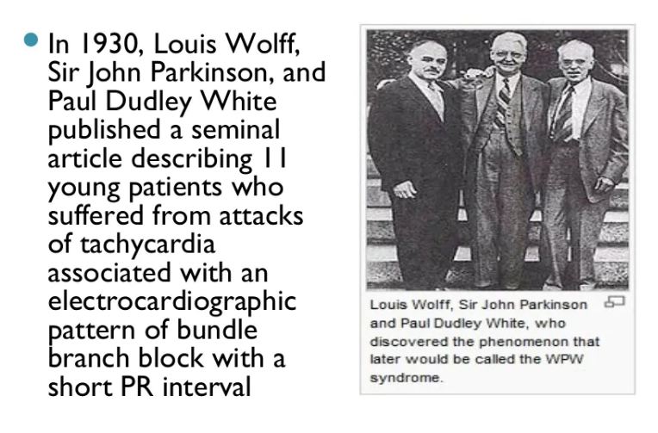

Slide 3
Atrioventricular Bypass Tracts
The cardiac skeleton consists of four rings of dense connective tissue that surround the AV canals (mitral and tricuspid) and extend to the origins of the aorta and the pulmonary trunk,
providing structure and support for the heart &
electrical isolation between the atria and the ventricles.

Slide 4
AVN function-
modulation of atrial impulse transmission to the ventricles
it receives, delays, and conveys atrial impulses to the ventricles

Slide 5
AV BTs -
aberrant muscle bundles that connect the atria to the ventricles outside of the normal AV conduction system.
found most often in the parietal AV junctional areas, including the paraseptal areas.
They breach the insulation

Slide 6
TYPES OF BYPASS TRACTS
Bypass tracts (BTs) are remnants of the atrioventricular (AV) connections caused by incomplete embryological development of the AV annuli
several types of BT
AV
atrionodal ( James fibers)
atrio-Hisian,
atriofascicular,
fasciculoventricular and
nodofascicular

Slide 8
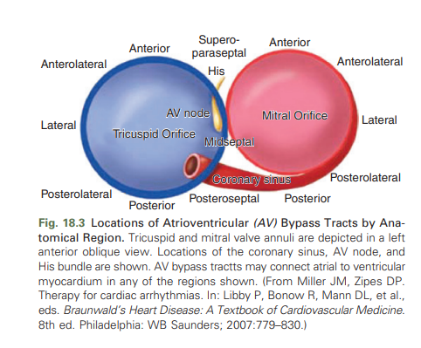

Slide 9
AVN-HPS, which lies in the septal component of the AV junction, is the only normal electrical connection between the atria and the ventricles.
The fibrous skeleton and AV valvular annuli (annulus fibrosus) act as insulators
Notes:
to prevent electrical impulses from conducting to the ventricles by any other route

Slide 10
AV BTs are aberrant muscle bundles that connect the atria to the ventricles outside of the normal AV conduction system. AV BTs are found most often in the parietal AV junctional areas, including the paraseptal areas.
left free-wall space (46% to 60% );
posteroseptal space (25% );
right free-wall space (13% to 21%);
right superoparaseptal (formerly called anteroseptal) space (7% ); and
Midseptum (<5%)

Slide 11
AV BTs are
usually short and very thin muscular strands (typically 5 to 10 mm in length, with a maximal diameter of 0.1 to 7 mm)
can course through the AV groove at variable depths ranging from subepicardial to subendocardial locations.

Slide 12
Multiple AV BT
occur in 5% to 10% of patients.
BTs are defined as multiple when they are separated by more than 1 to 3 cm at the AV junction.
The most common combination of widely spaced multiple BTs is posteroseptal and right free-wall BTs.
incidence high in patients with-
antidromic atrioventricular reentrant tachycardia (AVRT) (50% to 75%),
patients with AF resulted in ventricular fibrillation VF,
Ebstein anomaly.

Slide 13
AV BT classification based on conduction
Bidirectional BT (60%)
Anterograde only / manifest BT(<5%)
Retrograde only / concealed BT (17-37%)

Slide 14
AVN | AV BT
slow inward calcium current for generation and propagation of its action potential | Conduction-rapid inward sodium current
decremental conduction | all-or-none fashion (i.e., nondecremental conduction)
AV conduction is more rapid through the AV BT than through the AVN, a difference that is exaggerated at faster heart rates.
Notes:
Avbt-, similar to normal His-Purkinje tissue and atrial and ventricular myocardium
Avn -decremental conduction, whereby conduction time of the impulse propagating through the AVN prolongs as the atrial cycle length (CL) shortens.

Slide 15
Concealed Accessory Pathways
conduction only in the retrograde (VA) direction at rates similar or greater than the sinus rate.
noted in between15% to 42% of patients with accessory pathway.
Approximately one third of AVRTs are due to concealed accessory pathways.
no preexcitation on ECG during NSR,
rapid preexcited responses are not observed during AF.
Concealed pathways are more frequently localized to the left free wall (64%), and less frequently in Septal (31%) and right free wall locations.

Slide 16
Wolff-Parkinson-White Syndrome
1930 : Wolf, Parkinson & White described a syndrome that consisted of
Short PR-interval (<0.12 sec)
Bundle branch block on surface QRS
Paroxysmal tachycardia
1932: Wolferth and Wood – hypothesized Extra-nodal AV connections to be the basis for this syndrome
1969: Sealy et al surgically confirmed.

Slide 17
WPW pattern
constellation of ECG abnormalities related to the presence of a manifest AV BT i.e.
short PR interval,
delta wave,
wide QRS complex
in asymptomatic patients
Notes:
The initial part of ventricular activation resulting in the upstroke of the QRS complex is slurred because of slow muscle-to-muscle conduction; this is termed a delta wave.

Slide 18
WPW syndrome
combination of ventricular preexcitation and either a documented tachyarrhythmia or symptoms of a tachyarrhythmia

Slide 19
BT exhibits practically nondecremental conduction, the early ventricular activation (i.e., P-delta interval) remains almost constant at all atrial rates

Slide 20
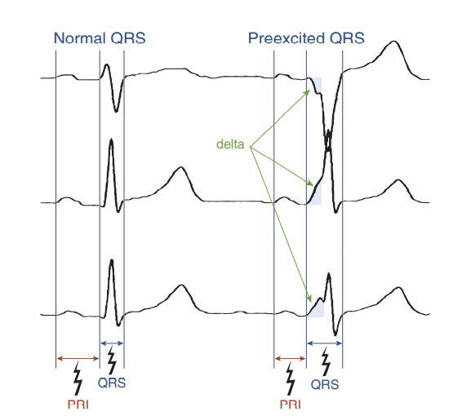

Slide 21
EPIDEMIOLOGY AND NATURAL HISTORY of WPW Syndrome
prevalence of WPW pattern on the surface ECG is 0.1-0.3% in the general population.
The prevalence is increased to 0.55% among first-degree relatives of affected patients, suggesting a familial component.
incidence in men is twice that in women, and
highest in the first year of life, with a secondary peak in young adulthood.

Slide 22
The WPW pattern on the surface ECG can be intermittent and can even permanently disappear with loss of anterograde but preserved retrograde conduction.
Loss of preexcitation has been observed in up to 31% of adults and
in 0% to 33% of children and adolescents over a 5-year time period.
Notes:
Intermittent and persistent loss of preexcitation may indicate that the BT has a relatively longer baseline ERP, which makes it more susceptible to age-related degenerative changes and variations in autonomic tone

Slide 23
The prevalence of the WPW syndrome is substantially lower than that of the WPW ECG pattern.
which can be potentially life-threatening in approximately 5% of patients.
The vast majority of patients in whom preexcitation is first uncovered after the age of 40 remain asymptomatic.

Slide 24
approximately 65% of adolescents and 40% of adults over 30 years of age with a WPW pattern on a resting ECG are asymptomatic.
Up to 70% of children (8 to 12 years of age) who are asymptomatic at the time of diagnosis of WPW ECG pattern remain asymptomatic over median follow-up of 57 months.
About 30% eventually develop an arrhythmic event, which can be potentially life threatening in approximately 10% of patients.
In contrast, only a minority (10%) of adults who are asymptomatic at the time of diagnosis of ventricular preexcitation develop cardiac arrhythmias over median follow-up of 67 months.

Slide 25
SCD
an overall risk of SCD in adults and children of 2.5 per 1000 personyears (or 3% to 4% over a lifetime).

Slide 26
Male vs female
Male
M predominance among WPW patients has been observed.
higher incidence of antidromic AVRT,
more prevalent left-sided BTs, and
shorter anterograde BT ERP.
usually present with AVRT at an older age than women.
Female
higher prevalence of multiple BTs,
orthodromic AVRT, and
right-sided BTs.

Slide 27
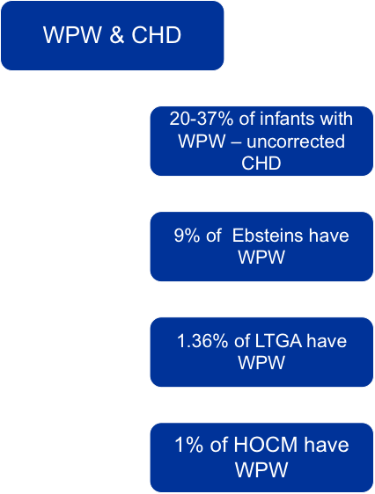

Slide 28
Ventricular preexcitation has also been described in patients with
transposition of great arteries (TGA)
pulmonary atresia (PA)
patent ductus arteriosus (PDA),
tetralogy of Fallot (TOF),
total anomalous pulmonary venous return (TAPVR), and
ventricular septal defects (VSD)

Slide 29
CLINICAL PRESENTATION
The majority are asymptomatic and are discovered incidentally on an ECG obtained for unrelated reasons.
The two most common types of arrhythmias in the WPW syndrome are AVRT and AF
AVRT, which in general is well tolerated by the patient when additional heart disease is absent, can deteriorate into AF;
AF can be a life-threatening arrhythmia if the BT has a short anterograde refractory period, resulting in very fast ventricular rates, with possible degeneration into VF and SCD
unusual for cardiac arrest to be the first symptomatic manifestation of WPW syndrome. Conversely, in about 50% of cardiac arrest cases in WPW patients, it is the first manifestation of WPW syndrome.

Slide 30
PJRT commonly presents as a frequently recurring or incessant tachycardia that is refractory to drug therapy
can lead to tachycardiainduced cardiomyopathy and heart failure symptoms.

Slide 31
Familial Wolff-Parkinson-White Syndrome
infrequently reported
inherited as an autosomal dominant trait.
presence of preexcitation on the ECG,
frequent SVTs (including AF),
progressive conduction system disease, and left ventricular (LV) hypertrophy

Slide 32
Patients typically present in late adolescence or the third decade with syncope or palpitations.
Premature SCD occurred in 10% of patients.
Paradoxically, by the fourth decade of life, progression to advanced SND or AV block (with the loss of preexcitation) requiring pacemaker implantation was common.
Approximately 80% of the patients older than 50 years had chronic AF.
Causative mutations in the PRKAG2 gene were identified in these families.

Slide 33
Arrythmias associated with BT
AVRT
AVNRT
PJRT
AF
AFL
VT
VF

Slide 34
Atrioventricular Reentry (AVRT)
macroreentrant tachycardia
circuit that consists of two distinct pathways, the normal AV conduction system and an AV BT, linked by common proximal (atrial) and distal (ventricular) tissues.
most common (80%) tachycardias associated with the WPW syndrome.
Types
orthodromic and
antidromic
Notes:
If sufficient differences in conduction time and refractoriness exist between the normal conduction system and the BT, a properly timed premature impulse of atrial or ventricular origin can initiate reentry.

Slide 35
orthodromic AVRT
Approximately 50% of BTs manifest (able to conduct bidirectionally) and
50% are concealed (able to conduct retrogradely only).
Therefore a WPW pattern may or may not be present on the surface ECG during NSR.
When preexcitation is present, the delta wave seen during NSR is lost during orthodromic AVRT
Orthodromic AVRT accounts for approximately 90% to 95% of AVRT episodes in patients with a manifest BT

Slide 36
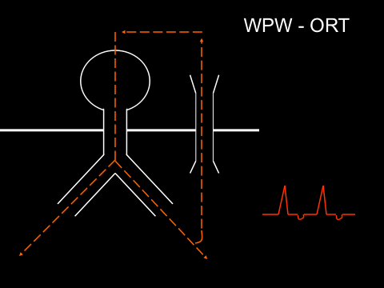

Slide 37
Antidromic Atrioventricular Reentrant Tachycardia
preexcited AVRT
preexcitation is typically observed during NSR.
the QRS complex during antidromic AVRT is fully preexcited
Clinically, antidromic AVRT is much less frequent than orthodromic AVRT, occurring in less than 5% of patients with WPW syndrome

Slide 38
Susceptibility to antidromic AVRT appears to be facilitated by a distance of at least 4 cm between the BT and the normal AV conduction system.
Consequently, most antidromic AVRTs use a lateral (right or left) BT as the anterograde route for conduction.

Slide 39
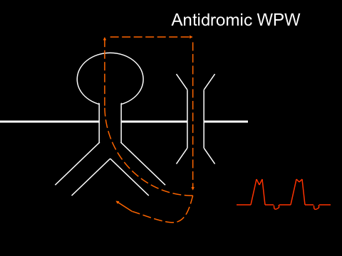

Slide 40
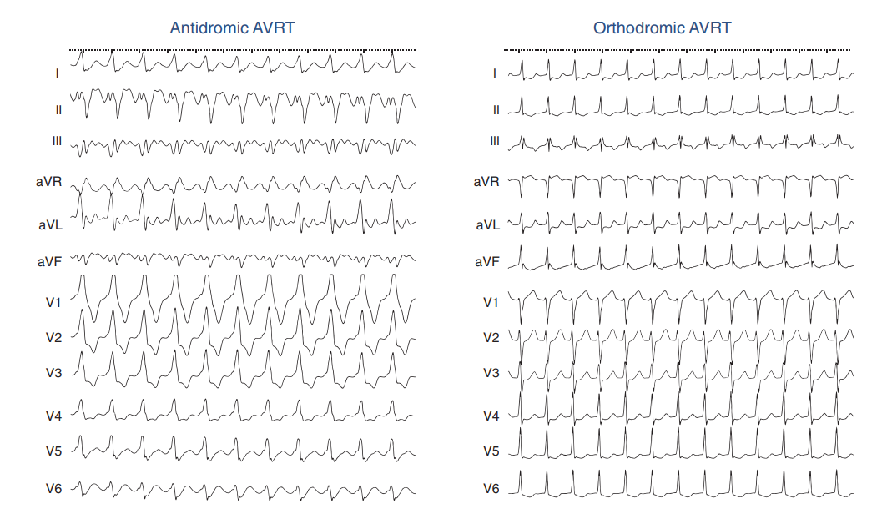

Slide 41
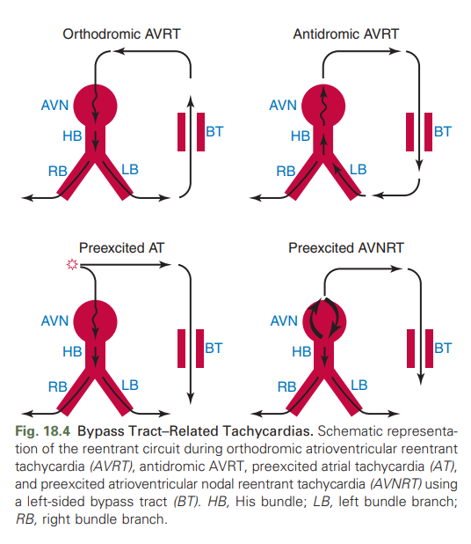

Slide 42
Permanent junctional reciprocating tachycardia (PJRT)
rare form of nearly incessant orthodromic AVRT
mediated by a concealed, retrogradely conducting AV BT that has slow and decremental conduction properties.
BT in PJRT is most often located in the posteroseptal region.
Because these BTs are almost always concealed and have slow conduction, all elements necessary for reentry are present at all times,
The incessant nature of PJRT can result in tachycardia-induced cardiomyopathy.

Slide 43
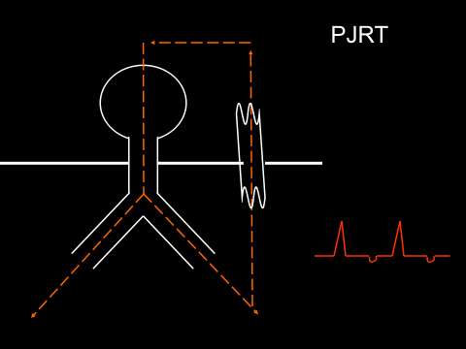

Slide 44
Atrial Fibrillation
The overall incidence of AF in patients with WPW syndrome varies from 12% to 39%.
AF is typically paroxysmal.
AF is most common in patients with anterogradely conducting BTs.
Patients with antidromic AVRT, multiple BTs, and BTs that have a short anterograde effective refractory period (ERP) are more prone to develop AF.
In individuals with WPW, AF is often preceded by AVRT that degenerates into AF.

Slide 45
The mechanisms by which AVRT precipitates AF are not well understood.
The rapid atrial rate can cause disruption in atrial activation and reactivation, creating an EP substrate conducive to AF.
most patients with BT and AF who undergo BT ablation are cured of both AVRT and AF is compatible with this hypothesis.

Slide 46
AFL
4% of WPW patients present with AFL.
AFL is the most common (60%) regular preexcited tachycardia in patients with WPW syndrome.
AFL is caused by a macroreentrant circuit within the RA and therefore exists independently of the BT, and AFL does not have the same causal association to AV BTs as AF.
AFL, like AF, can conduct anterogradely via a BT causing a preexcited tachycardia
AFL can potentially conduct 1:1 to the ventricles during a preexcited tachycardia, making the arrhythmia difficult to distinguish from VT

Slide 47
Ventricular Fibrillation and Sudden Cardiac Death
mechanism of SCD in patients with WPW is likely the occurrence of AF or AFL with a very rapid ventricular rate, which provokes VF
the incidence of SCD in patients with WPW syndrome is 0% -0.39% annually in several large case series.
The trigger for AF is generally an episode of AVRT.
In fact, most patients who have been resuscitated from VF secondary to preexcitation have a previous history of AVRT, AF, or both.
Nonetheless, SCD can be the first manifestation of WPW syndrome.

Slide 48
SCD HIGH RISK Factors
younger age (< 30 years),
male gender,
history of AF,
prior syncope,
associated congenital or other heart disease, and
familial WPW.

Slide 49
Low-risk WPW patients
older age,
lower tachyarrhythmia inducibility,
longer anterograde refractory ERP of BTs, and
low likelihood of baseline retrograde BT conduction or multiple BTs

Slide 50
WPW at increased risk for VF,
symptomatic AVRT,
septal location of the BT,
presence of multiple BTs, and
male gender.
In addition,the risk of SCD associated with WPW appears highest in the first two decades of life.

Slide 51
Ventricular Tachycardia
Coexisting VT is uncommon in patients with WPW syndrome because structural heart disease is very infrequent in this young patient population.

Slide 52
ELECTROCARDIOGRAPHIC FEATURES
The degree of preexcitation depends on several factors, including-
conduction time over the AVN-HPS,
conduction time from the SA node to the atrial insertion site of the BT (which depends on the distance, conduction, and refractoriness of the intervening atrial tissue), and
conduction time through the BT (which depends on the length, thickness, and conduction properties of the BT).

Slide 53
Preexcited ECG can simulate the pattern found in other cardiac conditions-
Pseudo infarction- A negative delta wave (presenting as a Q wave) can mimic a myocardial infarction (MI) pattern.
Conversely, a positive delta wave can mask the presence of a previous MI.
Intermittent WPW can also be mistaken for frequent premature ventricular complexes (PVCs).
If the WPW pattern persists for several beats- can be misdiagnosed as an AIVR or, if sufficiently rapid, VT.
WPW pattern is occasionally seen on alternate beats and may suggest ventricular bigeminy or electrical alternans.

Slide 54
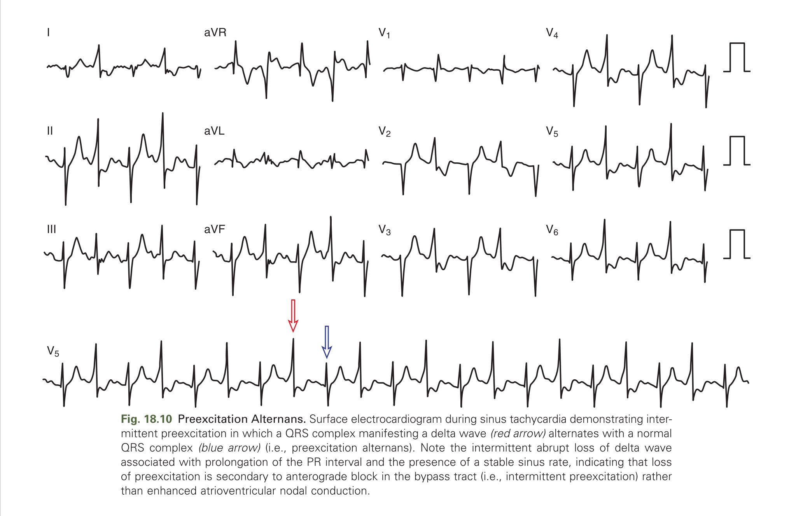

Slide 55
Inapparent Versus Intermittent Preexcitation
Inapparent preexcitation-
preexcitation is absent on the surface ECG despite the presence of an anterogradely conducting AV BT
because conduction over the AVN-HPS reaches the ventricle faster than that over the BT.

Slide 56
Inapparent preexcitation is usually caused by:
(1) enhanced AVN conduction, so that it is faster than conduction over the BT;
(2) prolonged intraatrial conduction from the site of atrial stimulation to the atrial insertion site of the BT (most often left lateral), favoring anterograde conduction and depolarization of the ventricle over the AVN-HPS; or
(3) prolonged conduction over the BT, so that it is slower than AVN-HPS conduction.

Slide 57
Intermittent preexcitation.
the presence and absence of preexcitation on serial ECGs or ambulatory cardiac monitoring
mechanism of intermittent preexcitation is poorly understood, Potential mechanisms include
phase 3 (i.e., tachycardia dependent) or phase 4 (i.e., bradycardia-dependent) block in the BT
anterograde or retrograde concealed conduction produced by PVCs, premature atrial complexes (PACs), or atrial arrhythmias;
BTs with a long ERP and the gap phenomenon in response to PACs; and
BTs with a long ERP and supernormal conduction.

Slide 58
Differentiation between intermittent preexcitation and inapparent preexcitation on an ECG showing QRS complexes with and without preexcitation can be achieved by
comparing the P-delta interval during preexcitation and the PR interval when preexcitation is absent.
Loss of preexcitation associated with a PR interval longer than the P-delta interval is consistent with intermittent preexcitation,
whereas loss of preexcitation associated with a PR interval shorter than the P-delta interval is consistent with inapparent preexcitation.
Notes:
Furthermore, maneuvers that slow AVN conduction (e.g., carotid sinus massage, AVN blockers) would unmask inapparent preexcitation but would not affect intermittent preexcitation.

Slide 59
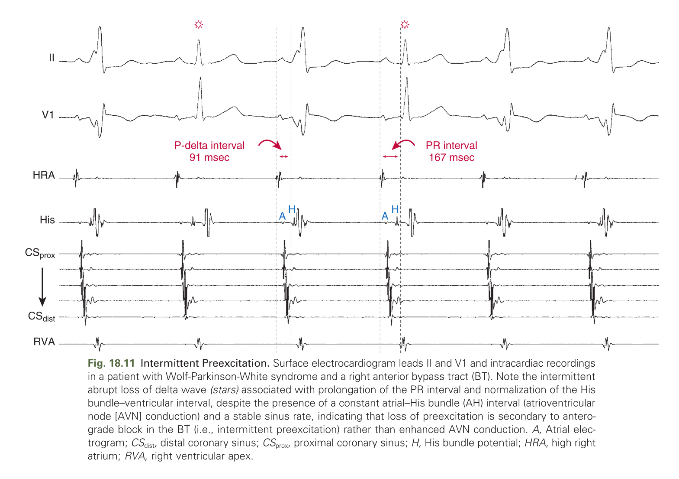

Slide 60
Electrocardiographic Localization of the Bypass Tract
provides the electrophysiologist with patient counseling regarding the risks and benefits of ablation.
it provides some guidance about the proximity of the BT to the normal conduction system and the subsequent risk of AV block associated with an ablation attempt,
as well as the need for left heart catheterization and atrial septal puncture and their potential complications.
In addition,help in planning the ablation procedure- use of cryoablation for septal BTs

Slide 61
Localization Using the Delta Wave
Delta wave morphology reflects the ventricular insertion site of the BT
However, during NSR, only partial ventricular preexcitation is usually observed, which limits the accuracy of BT localization based on the surface ECG.
In addition, the degree of preexcitation can vary in an individual, depending on heart rate, autonomic tone, and AVN function, as well as the location and EP characteristics of the BT.
assess delta wave polarity for localization (the first 20 to 60 milliseconds of the QRS in most cases, unless fully preexcited) rather than the overall QRS polarity, which may vary from each other.

Slide 62
algorithms facilitate prediction of the location of a BT,
algorithms should be regarded as an orientation rather than a precise localization tool.
algorithms appear most accurate in predicting left free-wall BT locations and least accurate in predicting midseptal or right anteroseptal BT locations

Slide 63
Limitations of algorithm
biological variability in anatomy (e.g., rotation of the heart within the thorax),
variable degree of preexcitation and QRS fusion,
the presence of more than one manifest BT,
intrinsic ECG abnormalities (such as prior MI and ventricular hypertrophy),
patient body habitus
technical variability in ECG acquisition and electrode positioning.

Slide 64
Therefore these algorithms should be regarded as an orientation rather than a precise localization tool.
No single published algorithm offers extremely high sensitivity and specificity for all BT locations.
The algorithms appear most accurate in predicting left free-wall BT locations and
least accurate in predicting midseptal or right anteroseptal BT locations.
Posteroseptal and right-sided BTs tend to be associated with a prominent degree of preexcitation because of the proximity to the sinus node, whereas left lateral BTs are often associated with subtle preexcitation

Slide 65
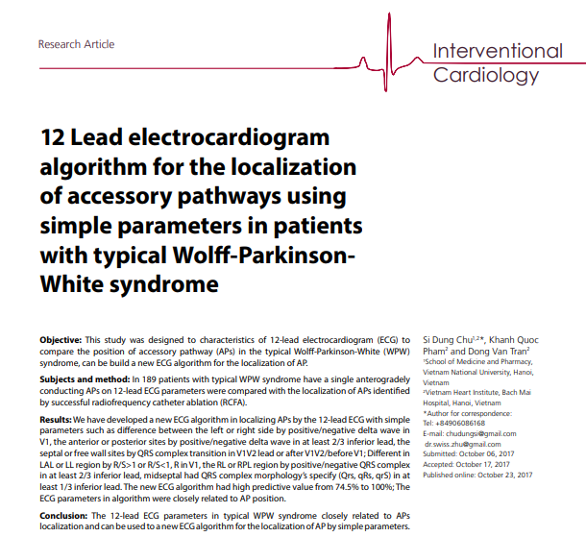

Slide 66
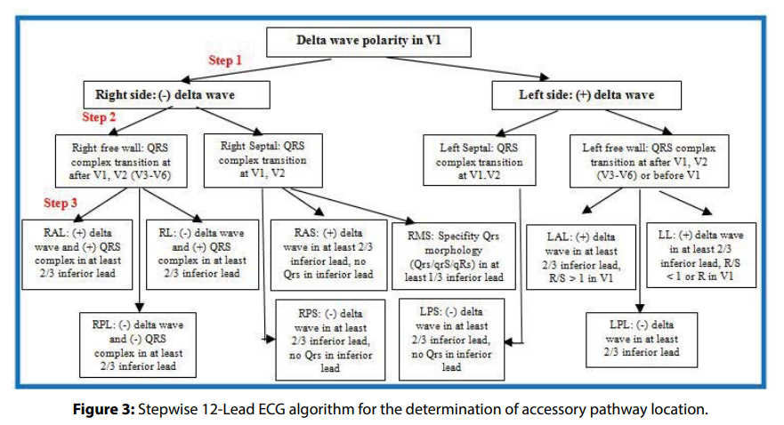

Slide 67
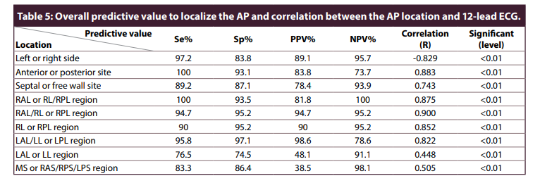

Slide 68
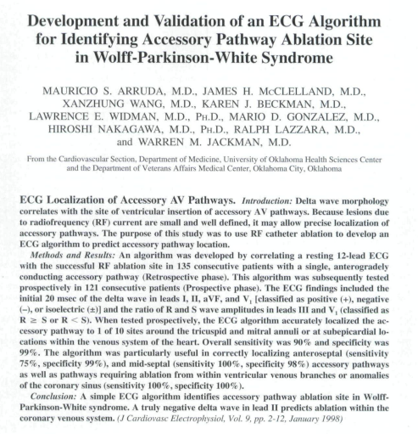
(J Cardiovasc Electrophysiol, Vol. 9, pp. 2-12, January 1998)

Slide 69
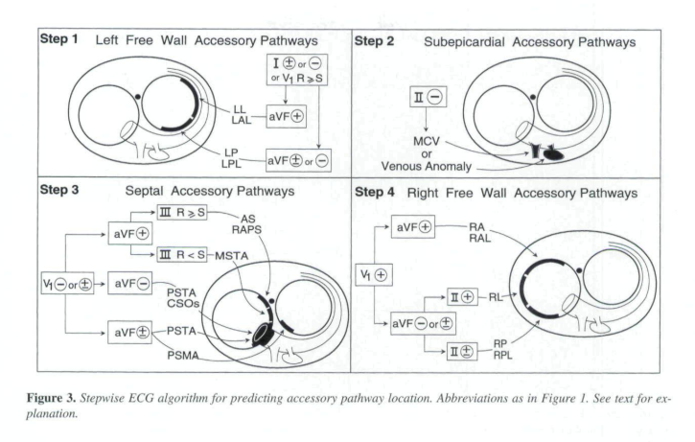

Slide 70
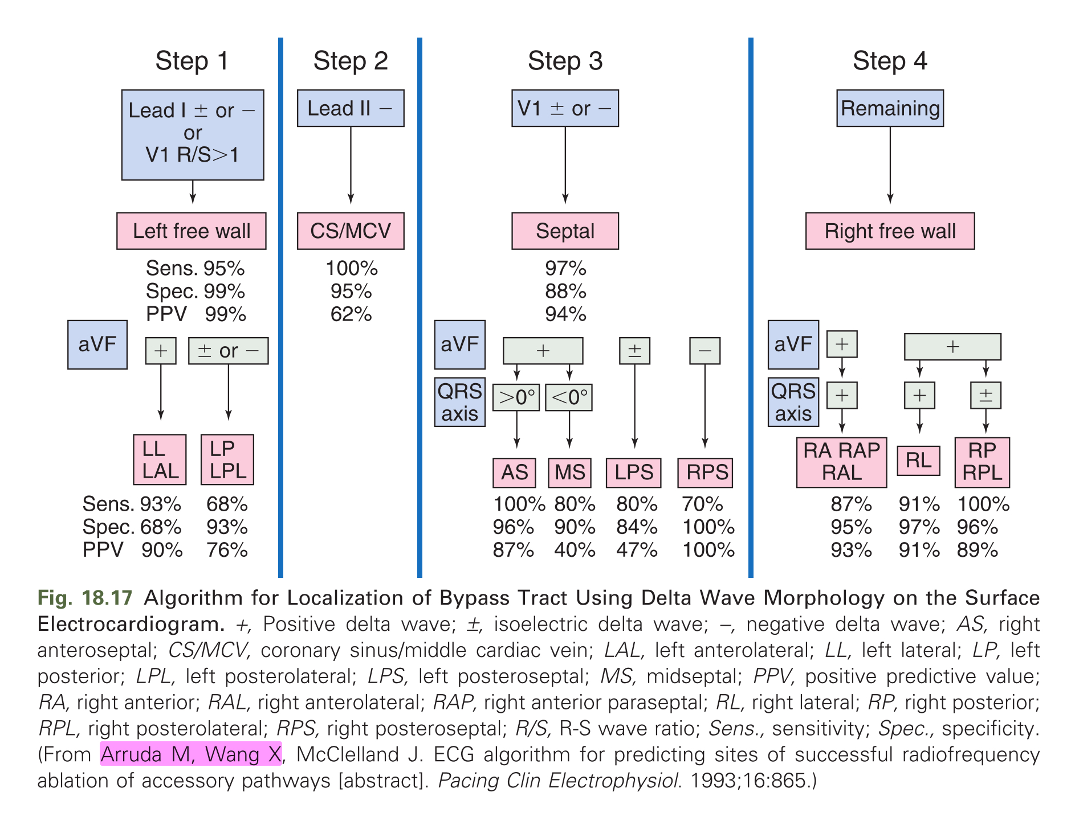

Slide 71
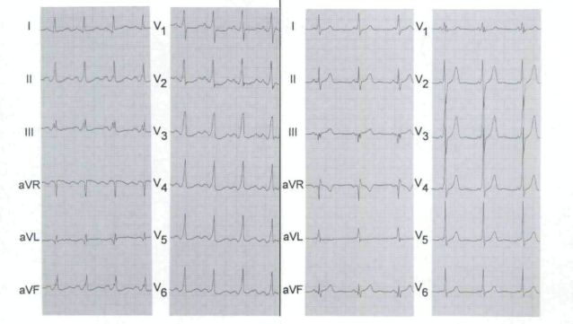
Notes:
Left Anterolateral / Left Lateral & Left Posterolateral / Left Posterior-Representative ECG from subjects with a teff free-watt accessory pathway. These patients are identtfied by a (-) or (±) delta wave tn tead I. or R > S tn tead V,. Delta wave polarity in lead aVf sublocates these accessory pathways.

Slide 72
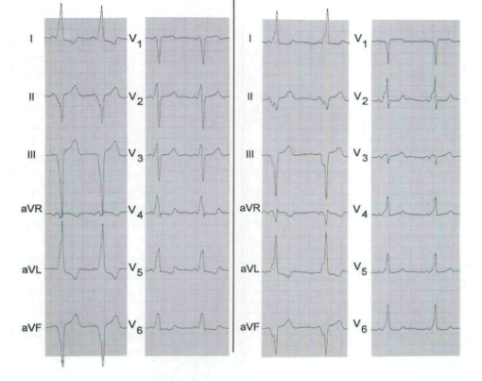
Notes:
Coronary Sinus Diverticulum & Middle Cardiac Vein -Representative ECG from subfects with a subepicardial accessory pathway. These patients are identified by a (~) delta wave in lead II (after excluding stibjects with a left free-wall acces.sory pathway). Note the typical pattem of the delta wave in lead II: it is negative and joins the end of the P wave.

Slide 73
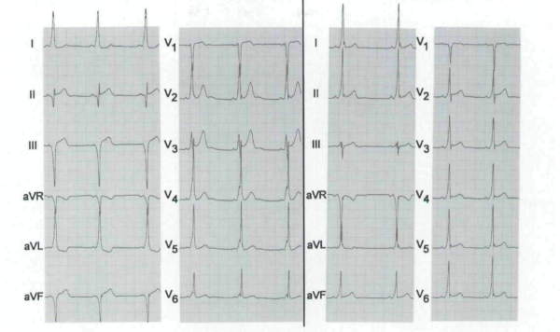
Notes:
Posteroseptal Tricuspid Annulus & Posteroseptal Mitral Annulus-Representative ECG from subjects with a septal acces.sory pathway. These patients are identified by a (-} or (±) delta wave in lead V, (after excluding subjects with a left free-wall or subepicardial accessory pathway). Delta wave polarity in lead aVF sublocates these septal accessory pathways. See text for discussion.

Slide 74
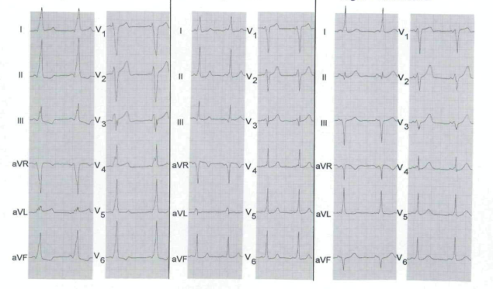
Notes:
RA/RAL- RL- RP/RPL---Representative ECG frotn subjects with a right free-wall accessory pathway. These patients are identified by excluding subjects with a lefi free-wall, subepicardial, or septal accessory pathway. See text to sublocate these accessory pathways at the free-wall tricuspid annul

Slide 75
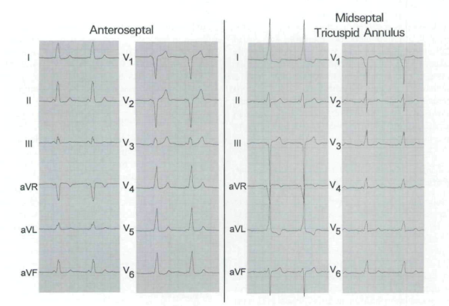
Notes:
Anteroseptal & Midseptal Tricuspid Annulus-These patients are identified by a (-) or (±) delta wave in lead V, (after excluding subjects with a left free-wall or suhepicardial accessory pathway). A < + ) delta wave polarity in lead aVF sublocates these septal acces.soiy pathways at either the midseptat or anteroseptal tricuspid annulus regions. The precise region is determined by the R/S ratio in lead III. See text for discussion.

Slide 76
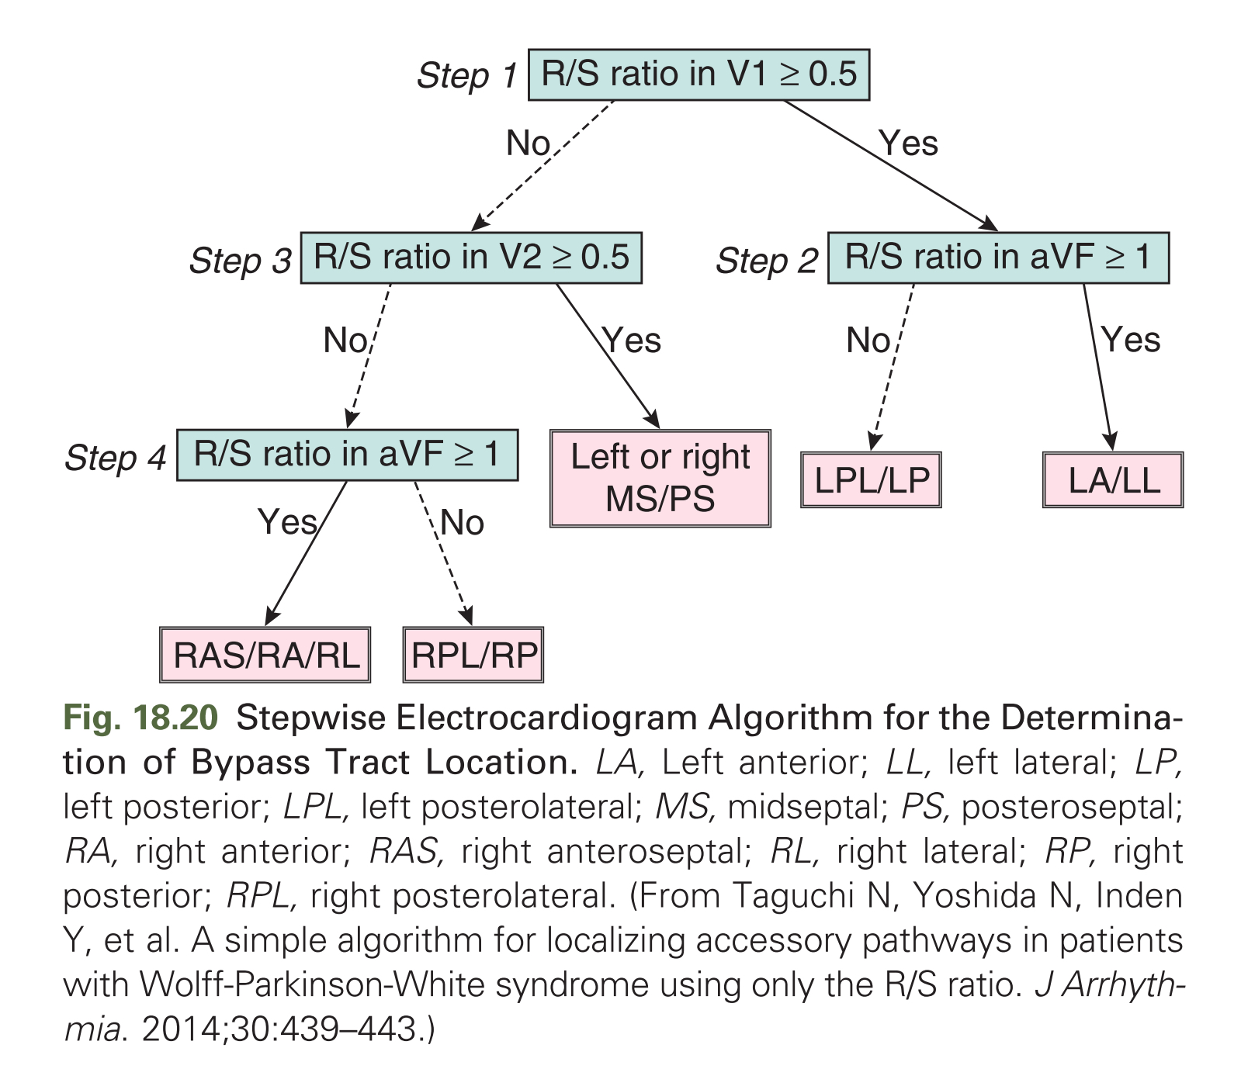

Slide 77
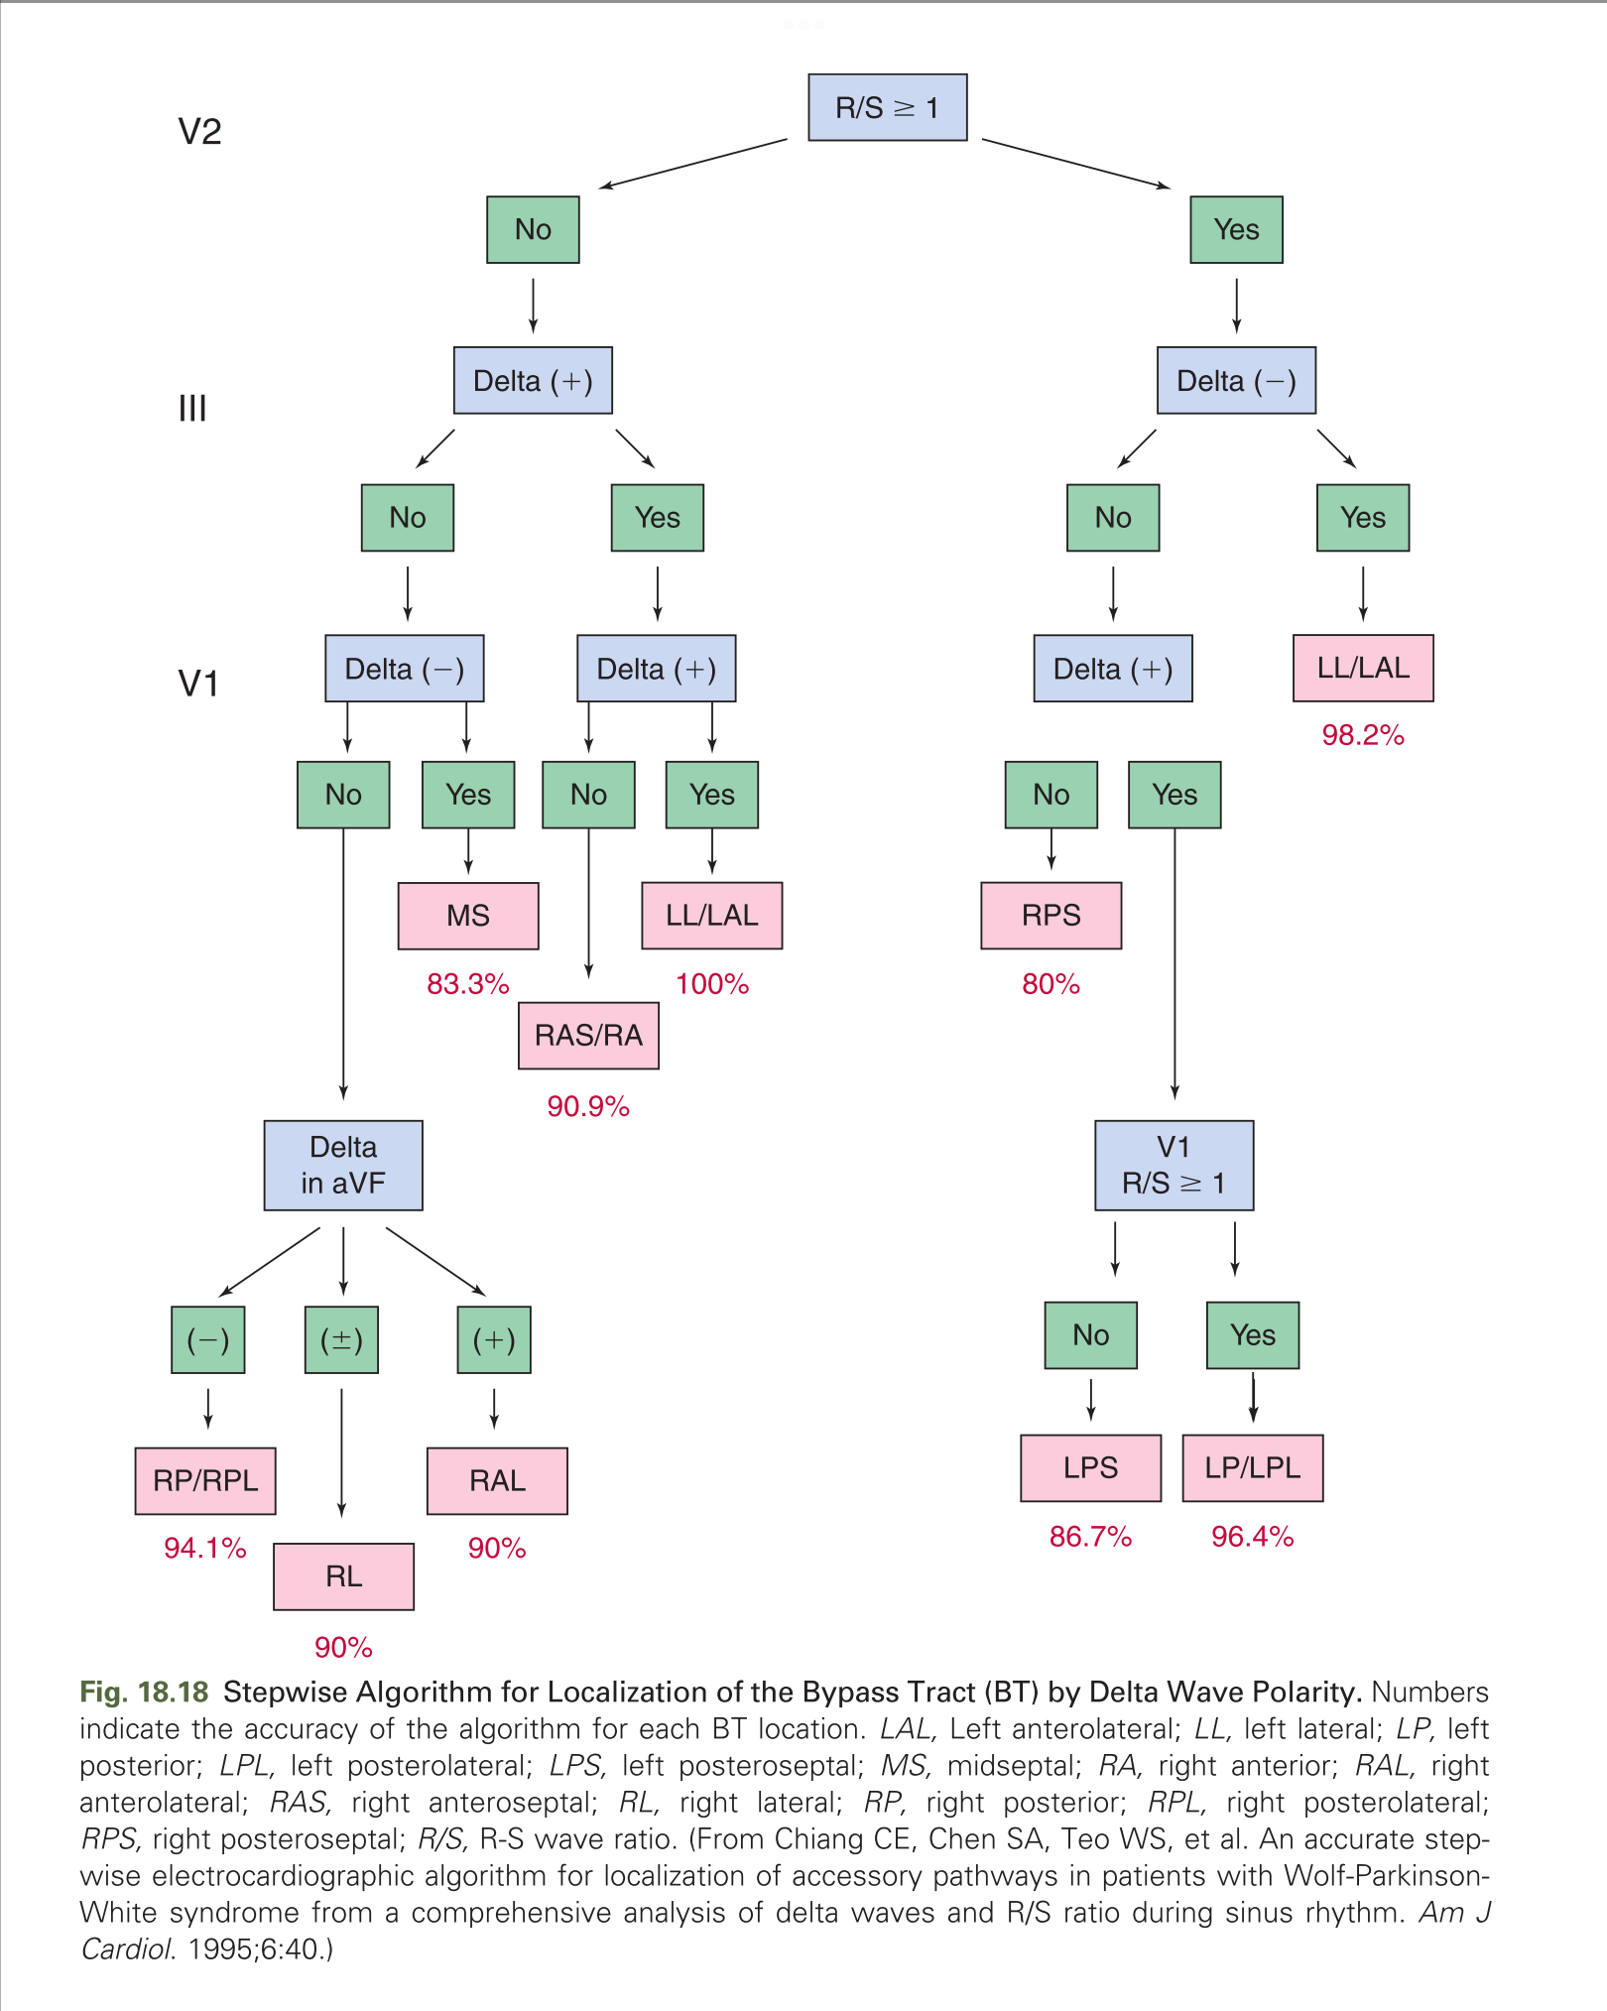

Slide 78
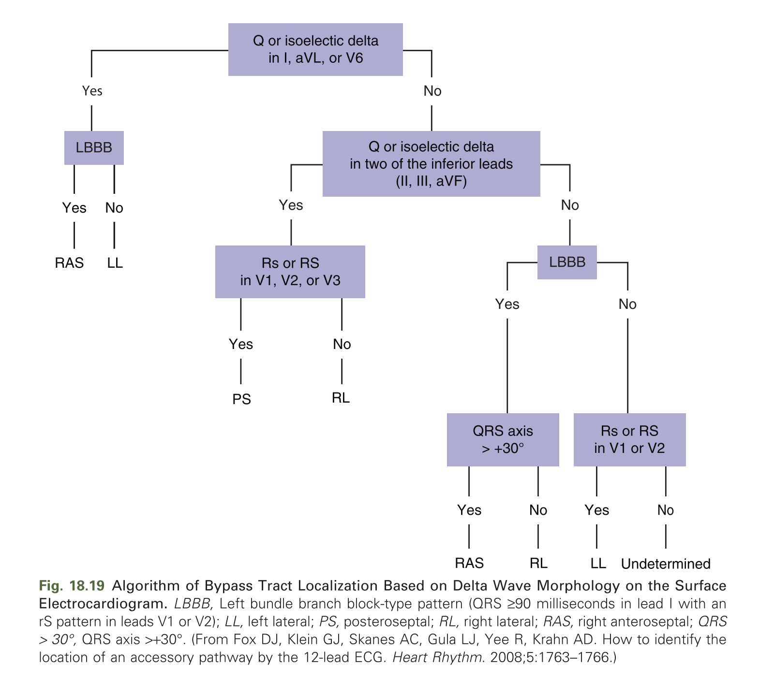

Slide 79
Precordial transition
left-sided BTs exhibit positive delta waves in lead V1,
while right-sided BTs exhibit negative delta waves.
The farther the BT is to the left or posteriorly on the mitral annulus, the larger the positive delta wave, and the farther the BT is to the right along the tricuspid annulus, the deeper the negative delta wave is in lead V1.

Slide 80
Frontal plane horizontal axis
Lead I primarily reflects the horizontal axis.
BTs closer to the left axilla will produce a deeply negative complex in lead I (i.e. rightward axis).
Conversely, BTs closer to the right axilla are strongly positive in lead I (i.e.leftward axis).

Slide 81
Frontal plane vertical axis.
The inferior leads (II, III, and aVF) reflect the vertical axis.
BTs located at the superior aspect of the tricuspid or mitral annulus exhibit positive deflections in the inferior leads (i.e., vertical axis).
The magnitude of the inferiorly directed vector diminishes as the site of origin shifts from superior to inferior regions of either annulus.

Slide 82
Left vs. right free-wall BTs
Ventricular activation originating from the right ventricle (RV) (as mediated by right-sided BTs) is expected to produce a predominantly negative deflection in right precordial leads, whereas more posterior or left-sided sites of origin produce more positive deflections.
Hence, an R/S ratio greater than 1 or a dominant R wave in lead V1 is consistent with left-sided BTs,
R/S transition after lead V2 suggests right-sided BTs.
R/S transition is at lead V2 or between leads V1 and V2, the R/S wave in the left lateral limb leads (I and aVL) favors right-sided BTs, otherwise left-sided BTs are likely.

Slide 83
Left-sided BTs
All left free-wall BTs exhibit positive delta wave polarity in the right precordial leads, an R/S ratio greater than 1, or a dominant R wave in lead V1.
BTs originating from the anterior mitral annulus exhibit larger R wave amplitudes in the inferior leads.
As the BT location shifts progressively more laterally, R wave amplitude becomes progressively larger in lead III and smaller in lead II.
The delta wave amplitude ratio in leads III/II is greater than 1 for posterolateral BTs and less than 1 for anterolateral BTs.
BTs located at the inferior aspects of the mitral annulus exhibit negative delta waves in the inferior leads.

Slide 84
Right-sided BTs
BTs arising from the tricuspid annulus demonstrate negative delta wave polarity in the right precordial leads and positive polarity in leads V5 and V6.
Right-sided BTs typically display a large positive delta wave in the left lateral limb leads (aVL and I), but a predominantly negative delta wave in lead aVR.
Positive delta waves in leads II and aVF are consistent with anteroseptal locations, whereas negative delta waves in the inferior leads suggest posteroseptal locations.
Flat or biphasic delta waves suggest midseptal locations.

Slide 85
Anteroseptal BTs.
Right superoparaseptal (anteroseptal) BTs -
Connect the RA and RV free walls at the anteromedial aspect of the tricuspid annulus.
these BTs exhibit positive delta waves in the inferior leads (II, III, and aVF).
delta waves are often negative in leads V1 and V2, but slightly positive (R/S < 1) delta waves also are observed.
Similar to right free-wall BTs, delta waves are typically positive in leads I and aVL and negative in lead aVR.

Slide 86
Midseptal BTs
The delta wave is positive in lead II,
Predominantly negative in lead III, and negative or isoelectric in lead aVF.
The delta wave in lead V1 is usually negative and R/S transition occurs after lead V2 (usually between leads V2 and V3).
Midseptal BTs can be differentiated from superoparaseptal and para-Hisian BTs by a negative delta wave in lead III, a biphasic delta wave in lead aVF, and a larger R/S ratio in lead V2, likely due to the posterior location of the AV septum compared to the anterior tricuspid annulus.

Slide 87
Posteroseptal BTs
Deeply negative delta wave in lead III.
negative delta wave in lead II predicts an epicardial location of the posteroseptal BT.
The delta wave in lead V1 can be negative, isoelectric, or positive.
Lead V2 typically displays a positive delta wave, with the R wave larger than the S wave.
A negative delta wave polarity in lead V1 with abrupt transition to positive polarity (with R/S ratio greater than 1) in lead V2 favors a right-sided location of the posteroseptal BT, whereas left posteroseptal BTs are often associated with biphasic or positive delta wave polarity in leads V1 and V2.
An R/S ratio greater than 1 in lead V1 is a more accurate marker of left posteroseptal BTs.
The tallest precordial R wave is typically recorded in the midprecordial leads (V2 to V4) in left posteroseptal BTs, and in the lateral precordial leads (V5 or V6) in right posteroseptal BTs.

Slide 88
Localization Using Polarity of the Retrograde P Wave Morphology
The polarity of the retrograde P waves during orthodromic AVRT is dependent on the location of the atrial insertion of the BT, and is helpful in localizing the BT.
However, the P wave is usually inscribed within the ST segment and its morphology may not be easily determined.
In general, P wave morphology in leads I and V1 and in the inferior leads is most helpful.
negative P wave vector in lead I is highly suggestive of left free-wall BTs, whereas a positive vector is suggestive of right free-wall BTs.
negative P wave in lead V1 predicts right-sided BTs.
P wave polarity in the inferior leads, positive or negative, suggests superior or inferior location of the BT, respectively.

Slide 89
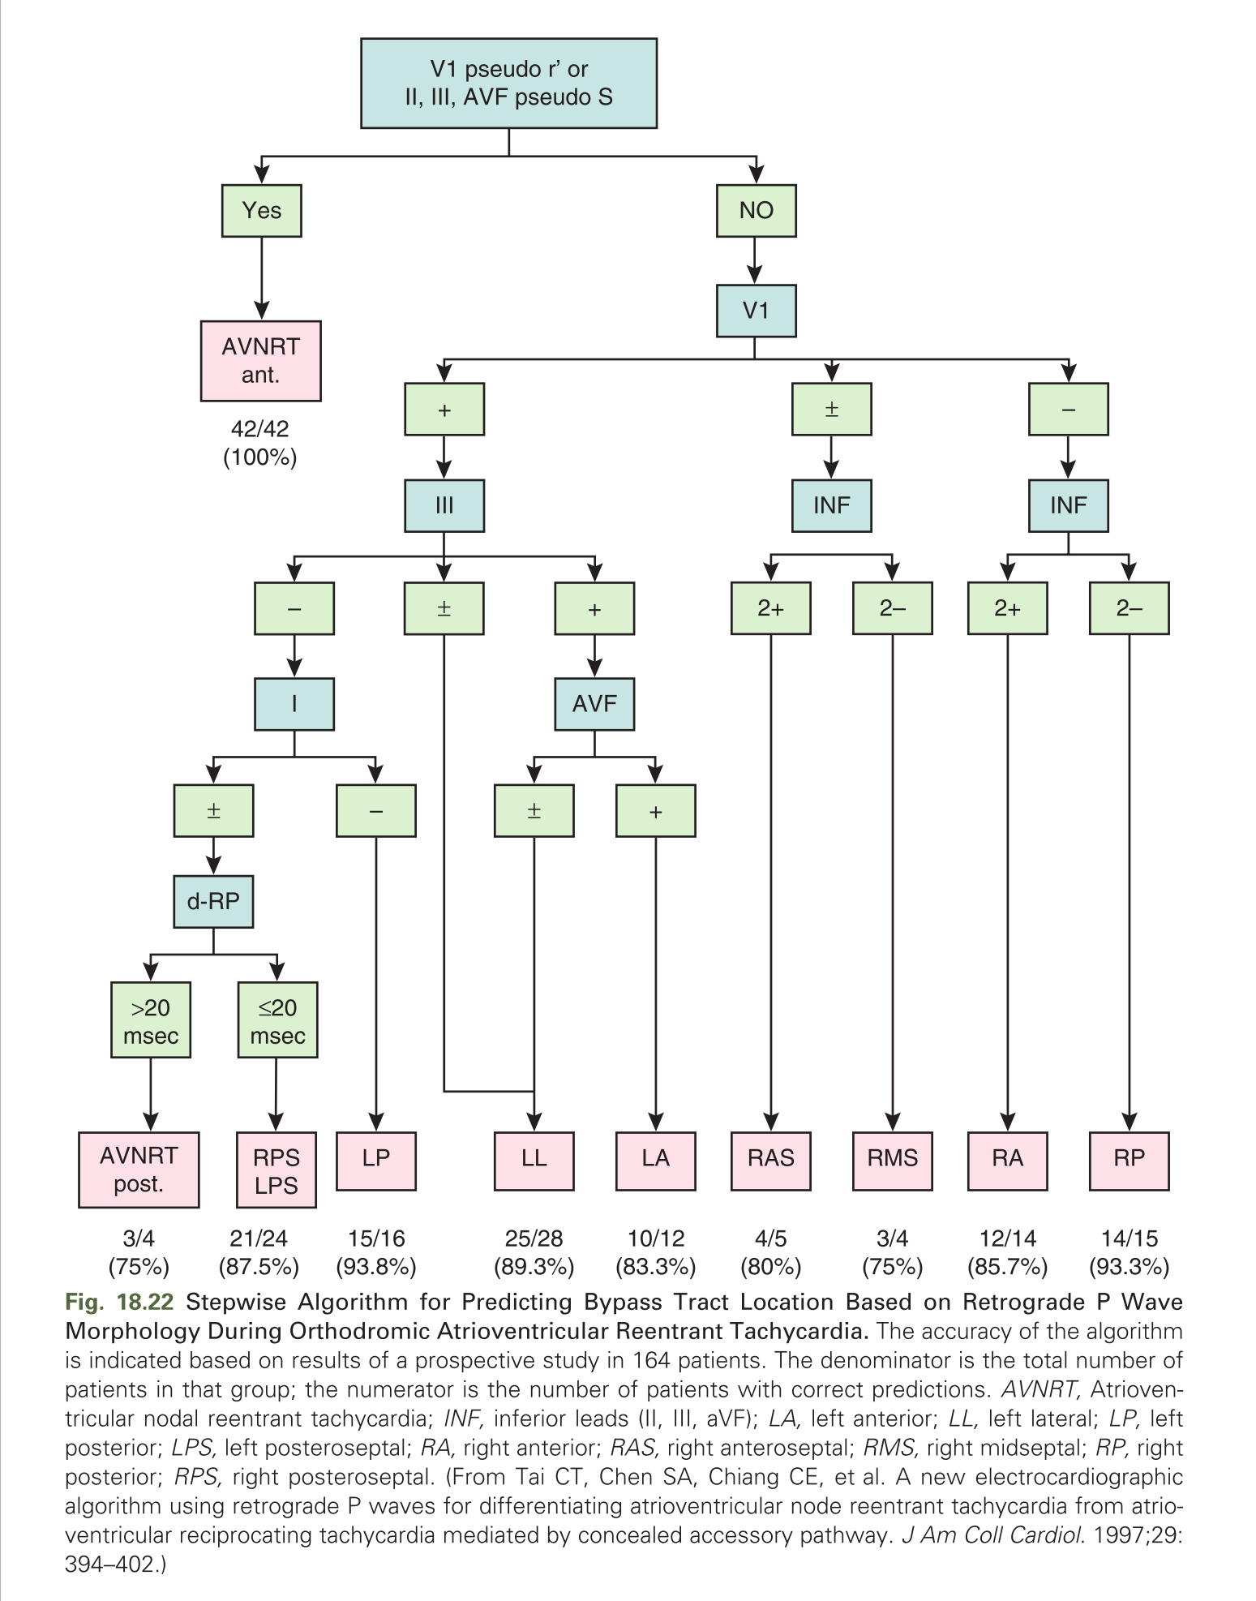

Slide 90
Evaluation
Invasive EP testing may be considered
when noninvasive testing does not lead to the conclusion that the anterograde ERP of the BT is relatively long.
However, a strategy to perform an EP study for all asymptomatic patients with the WPW ECG pattern for the purpose of risk stratification is still controversial and not widely accepted.

Slide 91
Methods for Evaluation of Bypass Tract Refractory Period
Demonstration of Intermittent Preexcitation
Loss of Preexcitation During Exercise
Bypass Tract Conduction Block in Response to Antiarrhythmic Agents
Evaluation of Ventricular Response During Atrial Fibrillation
Response of Preexcitation to Transesophageal Atrial Stimulation
Electrophysiological Testing

Slide 92
Demonstration of Intermittent Preexcitation
Observation of intermittent loss of the preexcitation pattern on ambulatory monitoring or serial ECGs is generally correlated with a long BT anterograde ERP.
decreases the frequency of manifest preexcitation during NSR and is expected to lower the risk of mediating rapid preexcited ventricular activation during AF.
Nevertheless, EP studies in symptomatic patients with intermittent preexcitation found that 10% to 24% can have BTs capable of conducting at rapid rates during AF (with anterograde ERP or shortest preexcited R-R interval less than 250 milliseconds), perhaps related to autonomic influences.

Slide 93
Loss of Preexcitation During Exercise
Demonstration of a sudden loss of preexcitation during exercise is consistent with block in the BT
consistent with a long BT ERP (greater than 300 milliseconds).
Importantly, rapid AVN conduction during exercise can potentially mask persistent preexcitation.
Therefore only abrupt and complete loss of preexcitation during exercise should be sought as a surrogate of a long anterograde ERP of the BT.
sensitivity of this test is poor.

Slide 94
Bypass Tract Conduction Block in Response to Antiarrhythmic Agents
administration of ajmaline (1 mg/kg IV over 3 minutes) or
procainamide (10 mg/kg IV over 5 minutes) results in complete block of the BT during NSR,
long anterograde ERP (greater than 270 milliseconds) of the BT is likely.
The shorter the BT ERP, the less likely it would be blocked by these drugs.

Slide 95
failure to produce block does not necessarily suggest a short ERP.
Limitation- pharmacological testing is carried out at rest and therefore does not indicate what effect the drug will have on the BT ERP during sympathetic stimulation, such as exercise, emotion, anxiety, and recreational drug use.
no longer routinely utilized.

Slide 96
Evaluation of Ventricular Response During Atrial Fibrillation
mean preexcited R-R interval > 250 milliseconds and a shortest preexcited R-R > 220 milliseconds predict low risk for SCD,
negative predictive value of more than 95%; however, the positive predictive value is low (20%).

Slide 97
Electrophysiological Testing
Programmed atrial stimulation is used to evaluate the anterograde ERP of the BT.
Because BT refractoriness shortens with decreasing pacing cycle length (PCL), the ERP should be determined at multiple PCLs (preferably ≤400 milliseconds).
atrial stimulation should be performed close to the BT atrial insertion site

Slide 98
Incremental-rate atrial pacing is performed to determine the maximal rate at which 1:1 conduction over the BT occurs.
Induction of AF should be performed to determine the average and the shortest R-R interval during preexcited AF.
Atrial and ventricular stimulation is also performed to evaluate inducibility of AVRT as well as the number and location of BTs.

Slide 99
shortest preexcited R-R interval less than 220 to 250 milliseconds
during AF has been shown to be the best discriminator of those at risk of VF, with a high sensitivity (88% to 100%) and a high negative predictive value for identifying children and young adults with WPW syndrome at risk for VF.
However, the positive predictive value is low (19% to 38%), largely due to the very low incidence of SCD in these patients.

Slide 100
Acute Management
Symptomatic Patients With Concealed Bypass Tracts
Patients with orthodromic AVRT utilizing a concealed BT are treated in a similar fashion as those with paroxysmal SVT.
Vagal maneuvers (including Valsalva and carotid sinus massage) are the first-line intervention for acute conversion of the tachycardia; (the overall success rate is approximately 28%).
If SVT persists, adenosine is recommended, and it offers a success rate of 90% to 95%.
For refractory tachycardia, IV diltiazem, verapamil, or beta-blockers can terminate orthodromic AVRT in the majority of patients.
Synchronized cardioversion is recommended for hemodynamically unstable patients and for those refractory or intolerant to drug therapy

Slide 101
Symptomatic Patients With Manifest Bypass Tracts
In patients with manifest preexcitation during NSR presenting with AVRT (orthodromic or antidromic),
vagal maneuvers are the first-line intervention for tachycardia termination (see Fig. 18.7).
For persistent SVT, adenosine is recommended.
adenosine should be used with caution because it can induce AF with a rapid ventricular rate in the presence of an anterogradely conducting BT.
This is unusual and should not be viewed as a contraindication to adenosine use, but one should be prepared for emergency cardioversion before administering adenosine to SVT patients.

Slide 102
For refractory AVRT, IV diltiazem, verapamil, or beta-blockers can be considered to block conduction in the AVN, which represents either the retrograde or anterograde limb in the AVRT circuit.
Drug treatment directed at the BT (ibutilide, procainamide, flecainide) may also be considered.
drug therapy fails or hemodynamic instability is present, electrical cardioversion should be considered.

Slide 103
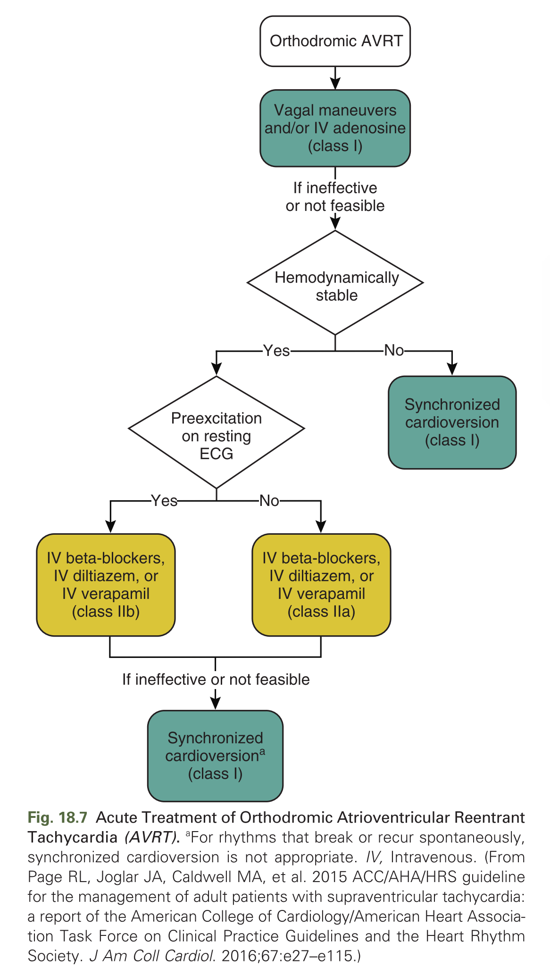

Slide 104
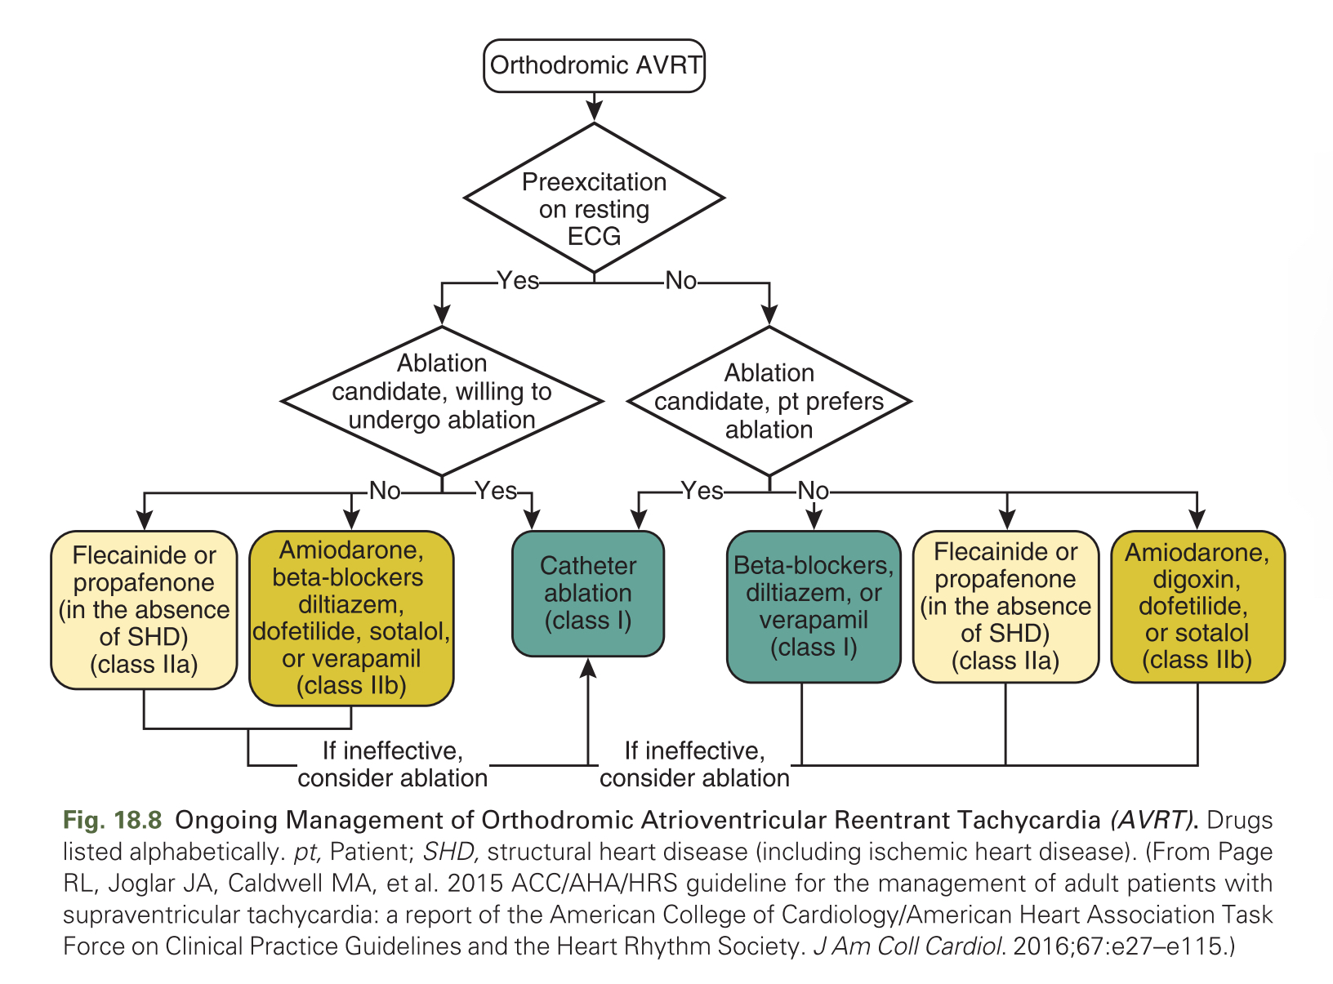
Chronic Management

Slide 105
Preexcited Atrial Fibrillation
In patients with AF or AFL, ventricular preexcitation, and rapid ventricular response,
prompt direct-current cardioversion is recommended, especially when hemodynamic compromise is present.
IV procainamide or ibutilide to restore NSR or slow the ventricular rate may be considered in hemodynamically stable patients.
Both drugs slow BT conduction.

Slide 106
Importantly, drugs that preferentially slow AVN conduction without prolonging BT refractoriness (such as verapamil, diltiazem, beta-blockers, adenosine, oral or IV digoxin, and IV amiodarone) can accelerate the ventricular rate and potentially precipitate hemodynamic collapse and VF in high-risk patients.
Unlike the IV route of administration, chronic oral amiodarone therapy can slow or block BT conduction.
Notes:
Several mechanisms are probably involved; hypotension produced by some of those medications is followed by a sympathetic discharge that enhances BT conduction. Furthermore, slowing or blocking conduction through the AVN prevents competitive concealed retrograde conduction into the BT by normally conducted beats and, as a result, can potentially enhance conduction over the BT.
Also, digoxin increases the ventricular rate by shortening BT refractoriness.
Lidocaine, for reasons that are unclear, has also been associated with degeneration of AF into VF. It is occasionally used in patients with WPW who have a wide QRS complex tachycardia that might be misinterpreted as VT.

Slide 107
Chronic Management
Symptomatic Patients With Concealed Bypass Tracts
Catheter ablation is considered first-line therapy (class I) for patients with paroxysmal SVT involving a concealed BT (i.e., orthodromic AVRT).
When pharmacological therapy is selected for patients with concealed BTs, it is reasonable to consider a trial of beta-blocker therapy, diltiazem, or verapamil.
These agents are effective for preventing recurrent tachycardia in approximately 50% of patients.

Slide 108
Symptomatic Patients With Manifest Bypass Tracts
Catheter ablation is considered the treatment of choice for patients with WPW syndrome—that is, patients with manifest preexcitation along with documented arrhythmias (antidromic or orthodromic AVRT or preexcited AF) or symptoms consistent with cardiac arrhythmias.
Catheter ablation is curative in more than 95% of patients with a relatively low complication rate (about 3%), and
obviates the unwanted side effects of pharmacological therapy.

Slide 109
not candidates for, or prefer not to undergo catheter ablation,
antiarrhythmic drugs to block BT conduction are considered.
Class IC agents such as flecainide and propafenone (in patients without structural heart disease or ischemic heart disease), and
class III drugs, such as sotalol and dofetilide, may be considered.
Oral amiodarone is a last resort therapy.
In general, antiarrhythmic drug therapy can offer symptomatic improvement in up to 90% of patients, although complete disappearance of symptoms is observed in only 30%

Slide 110
Chronic oral beta-blocker, verapamil, and diltiazem may be used
for the treatment of patients with WPW syndrome, particularly if their BT has been demonstrated to be incapable of rapid anterograde conduction
Digoxin, on the other hand, should be avoided because it can shorten the refractory period of the BT and, hence, is potentially harmful in patients with manifest BTs

Slide 111
Asymptomatic Patients With Manifest Bypass Tracts
recent Pediatric and Congenital Electrophysiology Society (PACES) and the Heart Rhythm Society (HRS) expert consensus document on treatment of asymptomatic young WPW subjects-
risk stratification is recommended
“high-risk” patients -the risk to benefit ratio favors prophylactic ablation
Initial risk stratification utilizes noninvasive testing (e.g., Holter monitoring, exercise stress testing) to ascertain true loss of preexcitation at physiological heart rates.

Slide 112
Inability to clearly demonstrate absolute loss of ventricular preexcitation on noninvasive testing warrants consideration for transesophageal or intracardiac EP testing.
The role of isoproterenol challenge during EP testing has not yet been clearly defined

Slide 113
Several EP findings help identify high risk patients who may benefit from catheter ablation, including:
(1) shortest preexcited R-R interval less than 250 milliseconds during induced AF;
(2) the presence of multiple BTs;
(3) spontaneous degeneration of induced AVRT into preexcited AF; and
(4) BT anterograde ERP less than 240 milliseconds.

Slide 114
low-risk patients, as determined by noninvasive or invasive testing,
follow-up with ECGs and
reevaluation at selected intervals with a high degree of suspicion for new arrhythmia symptoms.
This strategy should incorporate patient education
Once WPW patients become symptomatic, catheter ablation may be considered, regardless of the prior risk assessment.

Slide 115
Catheter ablation of the BT, regardless of BT characteristics, is also reasonable in asymptomatic patients with high-risk occupations (e.g., school bus drivers, police, and pilots), and
probably reasonable in:
(1) patients involved in moderate- to high-intensity competitive sports;
(2) patients with structural heart disease;
(3) patients with ventricular dysfunction secondary to dyssynchronous contractions; and
(4) patients with BT locations associated with lower risk of procedural complications (such as AV block or coronary artery injury), which can counterbalance the potential benefit of ablation.

Slide 116
The ability of noninvasive risk stratification to identify low-risk patients is low (less than 20%).
Hence, according to the 2012 PACES/ HRS Guidelines, invasive EP evaluation would be recommended for the majority of young asymptomatic WPW patients, and the majority of those would undergo catheter ablation

Slide 117
Wolff-Parkinson-White Patients and Sports Participation
WPW syndrome accounts for approximately 1% of deaths in athletes.
Although many of the cases of SCD with WPW are associated with exercise, training does not alter the EP properties in WPW.
For asymptomatic WPW patients engaged in moderate- to high-level competitive sports, noninvasive and, if needed, invasive risk stratification is advisable.

Slide 118
low-risk patients, as determined by noninvasive or invasive testing, BT ablation may still be appropriate,
but competitive sports may be allowed without ablation, especially when BT ablation confers an unacceptable potential risk (e.g., AV block in the setting of midseptal or superoparaseptal BTs).

Slide 119
Thank you

Slide 123
atypical bypass tract (BT)
conduction pathway that bypasses all or part of the normal conduction system but is not a rapidly conducting pathway connecting atrium and ventricle near the mitral or tricuspid annulus.
Thus pathways that connect the
atrium to the His bundle (HB) (atrio-Hisian BT),
atrioventricular node (AVN) to the His-Purkinje system (HPS) (nodofascicular BT), or
ventricle (nodoventricular BT), or
HPS to the ventricle (fasciculoventricular BT) fit into this designation

Slide 124
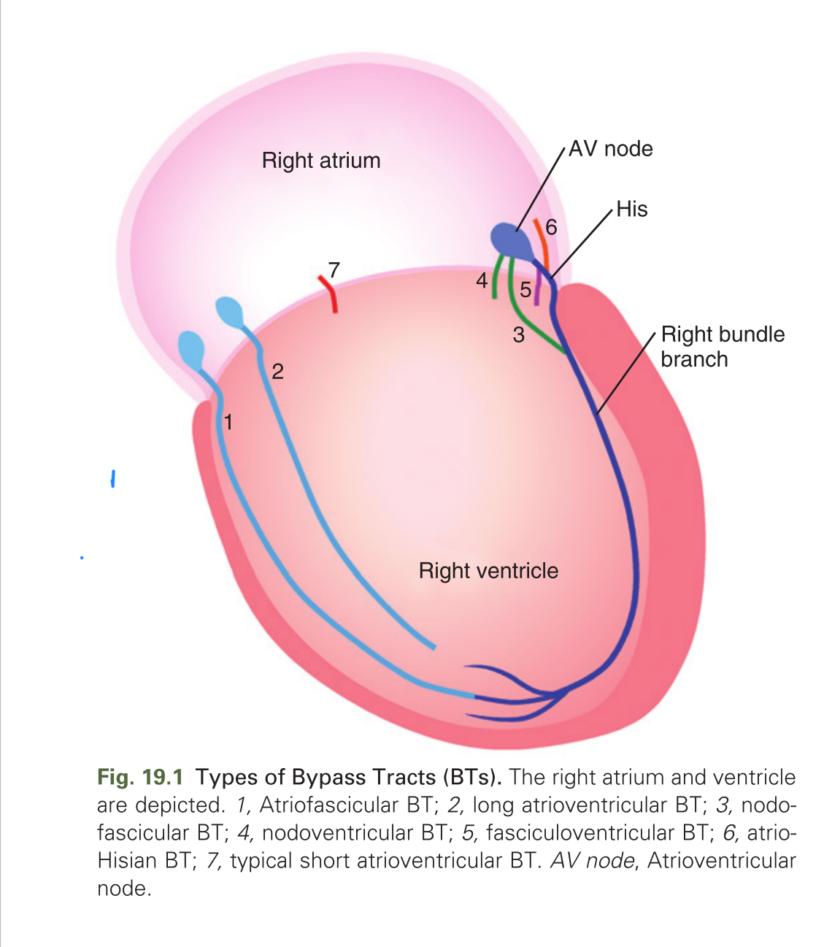

Slide 131
Localization Using Polarity of the Retrograde P Wave Morphology
Left free-wall BTs
positive P waves in lead V1 and negative P waves in leads I and aVL.
retrograde P wave is negative in all three inferior leads, the BT is located at the inferoposterior mitral annulus.
As the BT location moves to the lateral mitral annulus, the P wave becomes isoelectric or biphasic in one of the three inferior leads. The P wave becomes positive in all inferior leads for left anterior/anterolateral BTs.
as the BT moves from posterior to anterior locations along the mitral annulus, the positive P wave is seen initially in lead III, followed by lead aVF and lead II.

Slide 132
right free-wall BTs,
P wave is negative in lead V1 and positive or isoelectric in lead I.
If the P wave is positive in all inferior leads, the BT is located in the anterior wall.
the P wave is negative in all inferior leads, the BT is located in the posterior wall.
However, moving from the posterior to the anterior location, the positive P wave is seen initially in lead II, followed by lead aVF and lead III.

Slide 133
Posteroseptal BTs
positive P waves in leads V1, aVR, and aVL, and isoelectric or biphasic P waves in lead I.
P waves are negative in all inferior leads (II, III, aVF).
Left posterior BTs
have negative P waves in the inferior leads,
P waves are more negative in lead II than in lead III and are more positive in lead aVR than in lead aVL.
Discrimination between left and right posteroseptal BTs based on P wave morphology is limited.
In contrast, anteroseptal BTs display positive P waves in inferior leads and biphasic P waves in lead V1.

Slide 136
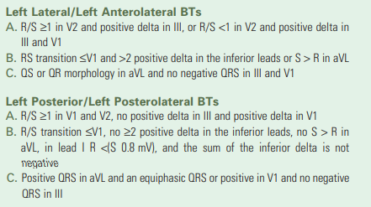

Slide 137
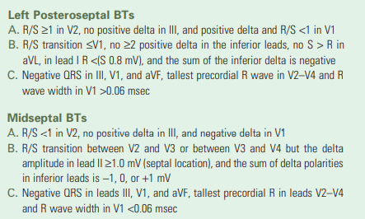

Slide 138
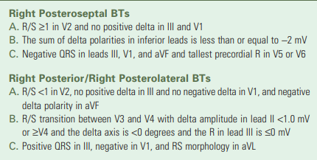

Slide 139
